Slide 1
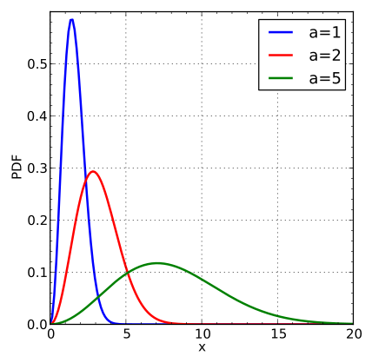

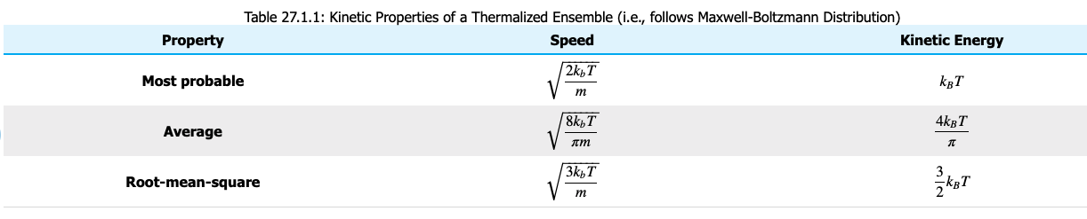


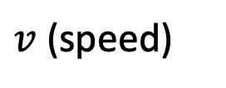




Recap of probability distributions and the three c’s
$$f_{M}$$
$$c^{∗}$$
$$\overline{c}= <v>$$
$$c= <v^{2}>^{1/2}$$
The $<…>$notation means “take the average of what’s inside the brackets”
$v$ (speed)
$c^{∗}<\overline{c}<c$

Slide 2
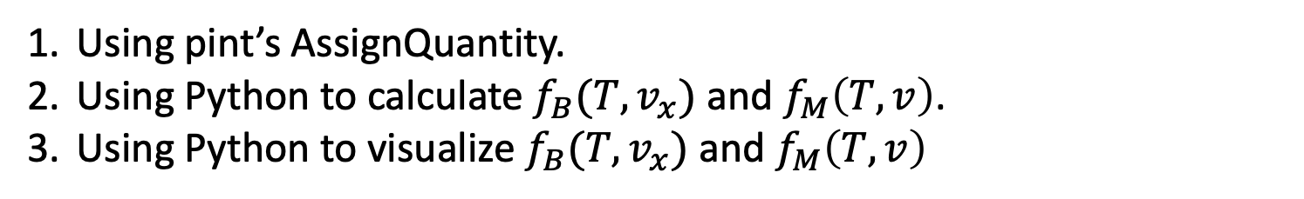
What we’re up to today
Using pint’s AssignQuantity.
Using Python to calculate $f_{B}(T,v_{x})$ and $f_{M}\left(T,v\right)$.
Using Python to visualize $f_{B}(T,v_{x})$ and $f_{M}\left(T,v\right)$

Slide 3
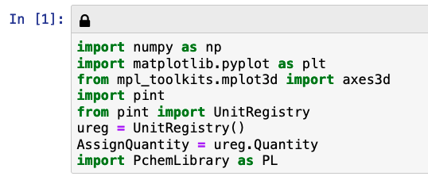
Using pint’s AssignQuantity
AssignQuantity gets defined at the start

Slide 4

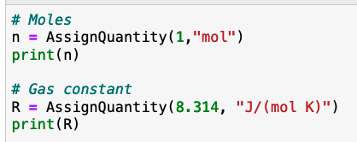
Using pint’s AssignQuantity
What we did before:
What we need to do now:

Slide 5
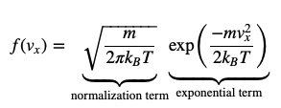
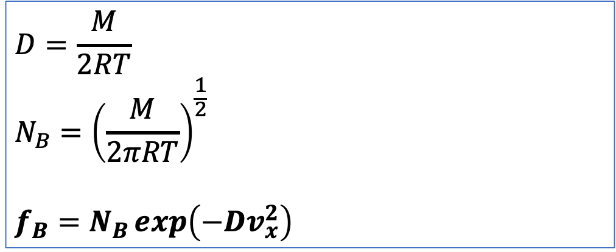
Using Python to calculate $f_{B} (T,v_{x})$and $f_{M} (T,v)$
Text:
Our notation:
$$D=\frac{M}{2RT}$$
$${N_{B}=\left(\frac{M}{2πRT}\right)}^{\frac{1}{2}}$$
$$f_{B}=N_{B}\exp\left(−Dv_{x}^{2}\right)$$

Slide 6
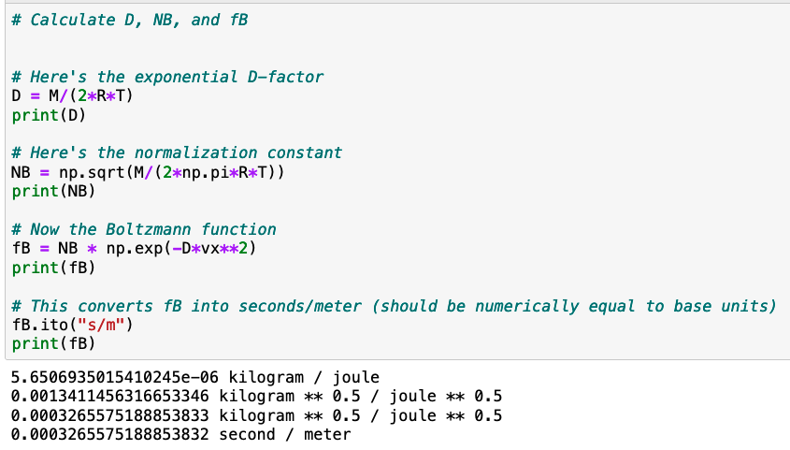

Using Python to calculate $f_{B} (T,v_{x})$and $f_{M} (T,v)$
$$D=\frac{M}{2RT}$$
$${N_{B}=\left(\frac{M}{2πRT}\right)}^{\frac{1}{2}}$$
$$f_{B}=N_{B}\exp\left(−Dv_{x}^{2}\right)$$

Slide 7
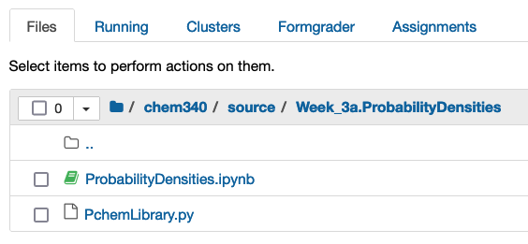
Using Python to visualize $f_{B} (T,v_{x})$and $f_{M} (T,v)$
This file contains our Statespace function!
(also dF_dx and dF_dy)
This line imports those functions!

Slide 8
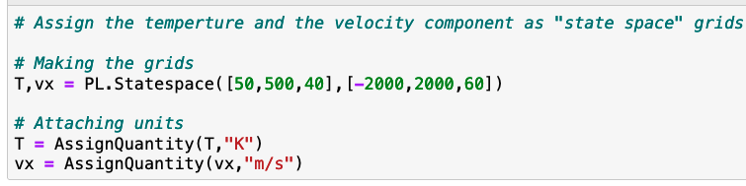
Using Python to visualize $f_{B} (T,v_{x})$and $f_{M} (T,v)$
Have to put “PL.” in front to use the functions in PchemLibrary.py
“T” and “vx” are grids not but we didn’t name them “Tgrid” etc. because it’s a little clumsy.
Then we attach units using AssignQuantity again

Slide 9
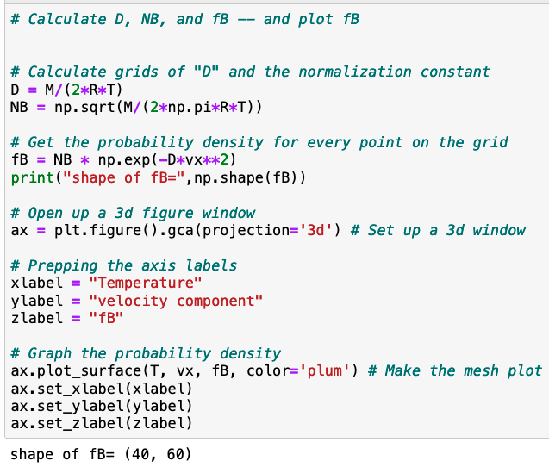
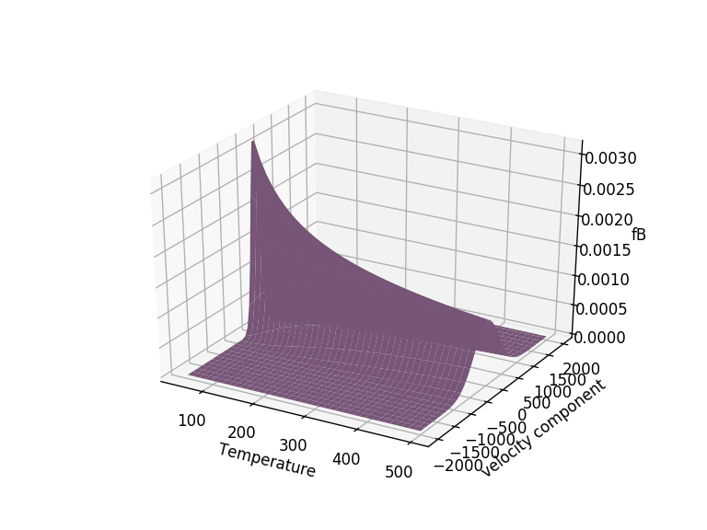
Using Python to visualize $f_{B} (T,v_{x})$and $f_{M} (T,v)$

Slide 10
